Slide 1

Data report

Slide 2
DWI arrest data
Arrest data location
Race, age, and sex of defendant
Time of day and day of week
Reason for traffic stop or contact
Felony or Misdemeanor DWI
Specimen refusal rate
Was blood search warrant obtained
Average BAC
What substance caused intoxication
Alcohol vs Drug related
Toxicology
Final case disposition

Slide 3
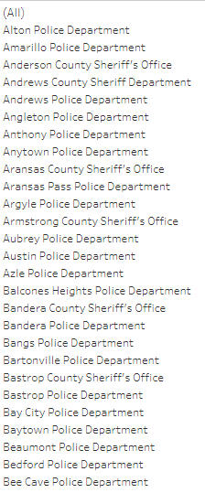
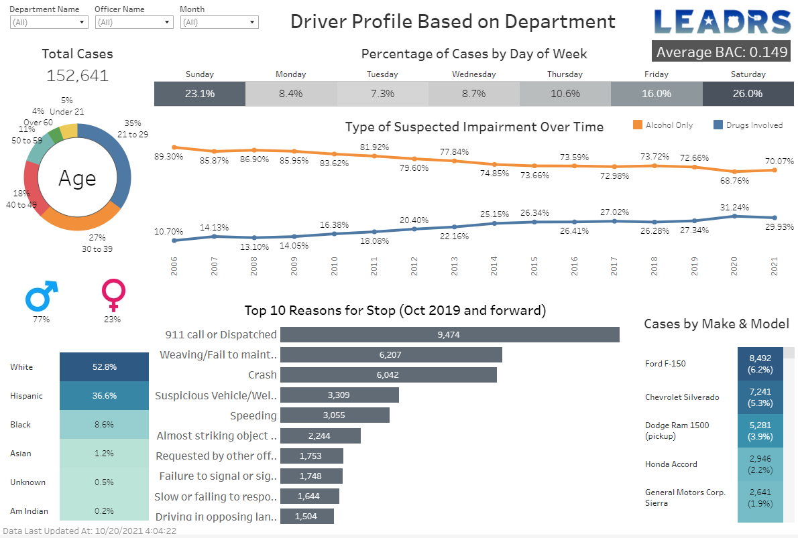

Slide 4
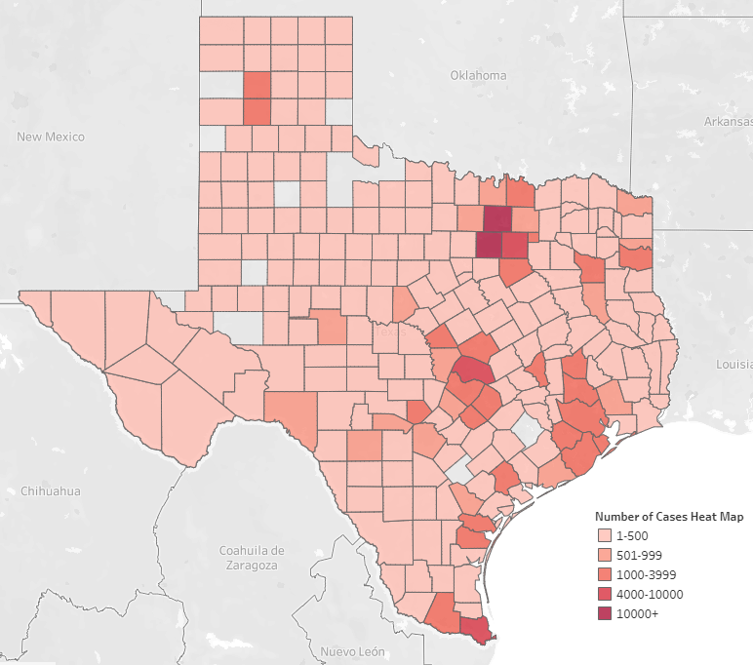
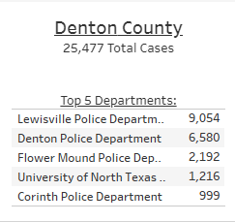
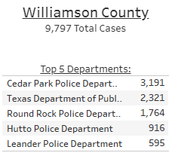
LEADRS Usage by County

Slide 5
Sample data report
Selected Denton & Williamson Counties from 2018 based on:
Widespread usage across the county
Selected 2018 due to likely final case disposition from the courts
Wanted to avoid court system COVID-19 impact on the data

Slide 6
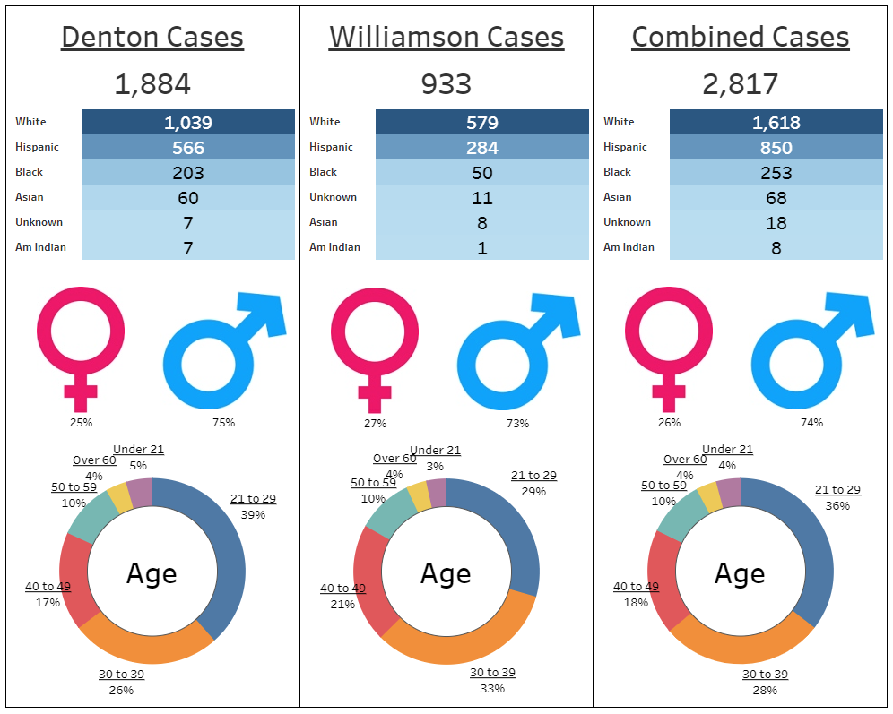
2018
January –
December

Slide 7
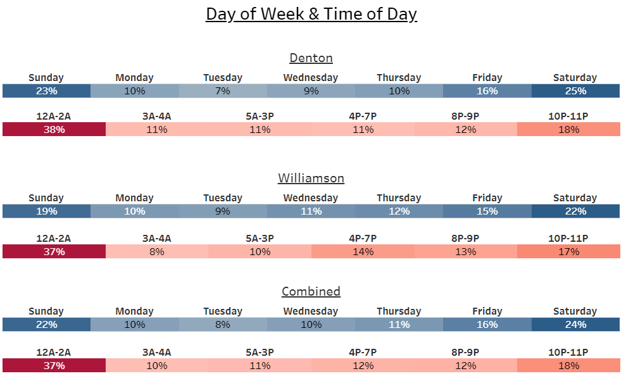
LEADRS DWI Arrest

Slide 8
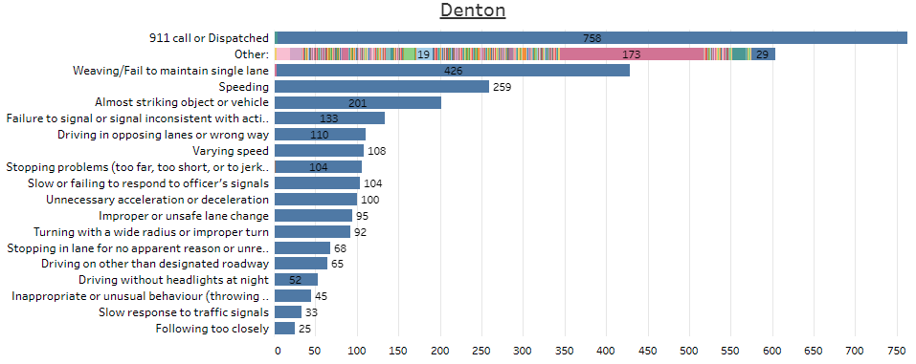
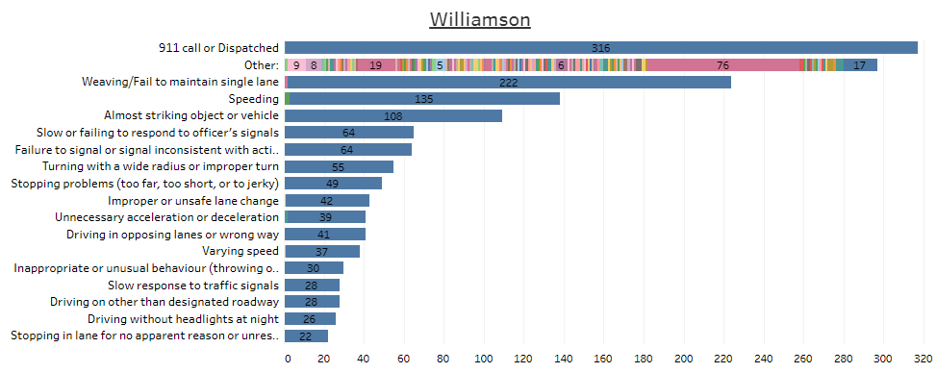
2018 Reason for traffic stop or contact

Slide 9
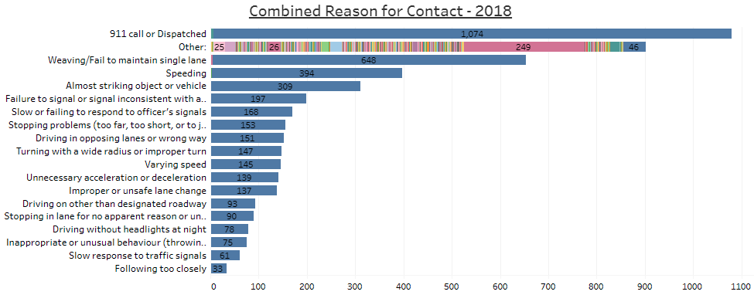
2018 Reason for traffic stop or contact
Both Williamson & Denton combined
“OTHER” was selected too many times
“OTHER” reason was analyzed to determine how to clean up data for future cases.
New option list was published in October 2019

Slide 10
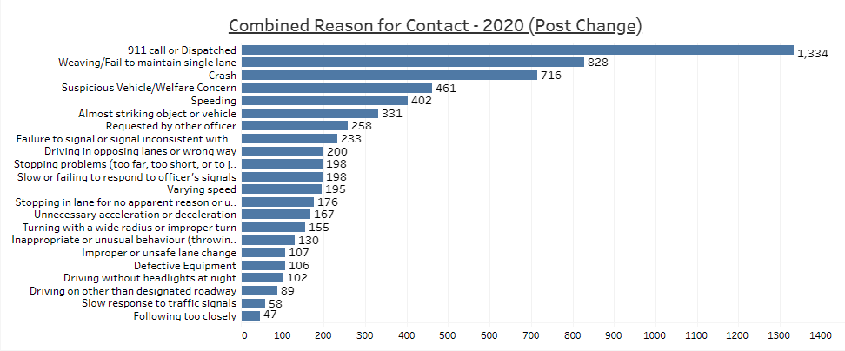
New updated Reason for Stop
Denton & Williamson Counties
2020
All “OTHER” responses have been updated in new options.
“OTHER” as an option was eliminated.
CRASH rose to #3 in Denton and Williamson Counties for 2020

Slide 11
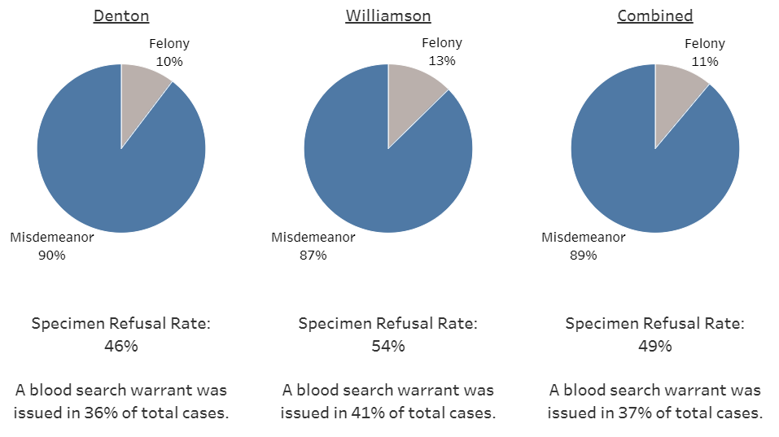
195
118
313
DWI Arrest
DWI Arrest
DWI Arrest
815
2504
1689

Slide 12
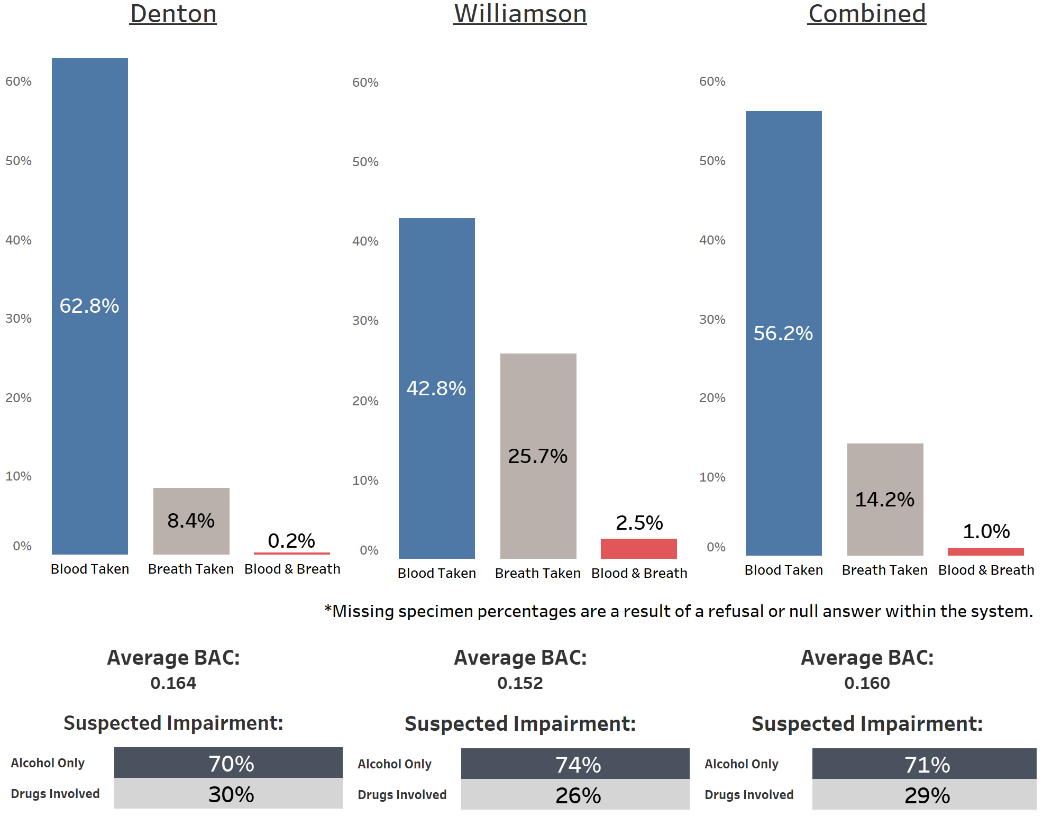
29% Involved drugs

Slide 13
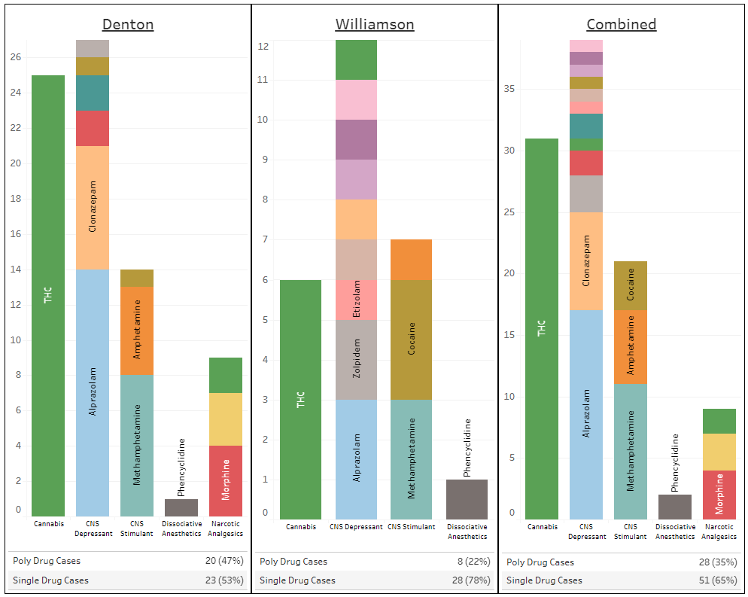
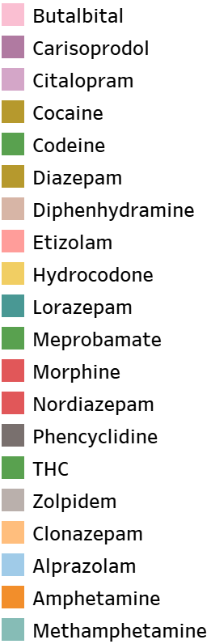
DWI arrest involving drugs:
All Toxicology results from blood specimens
Hydrocodone

Slide 14
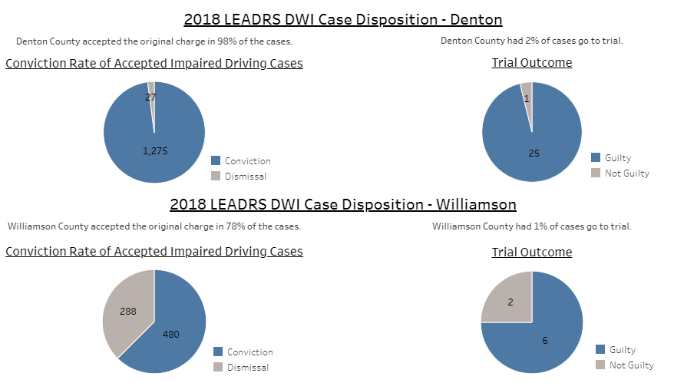
Conviction rate of accepted DWI arrest
98%
Conviction rate
Conviction rate of accepted DWI arrest
63%
Conviction rate

Slide 15
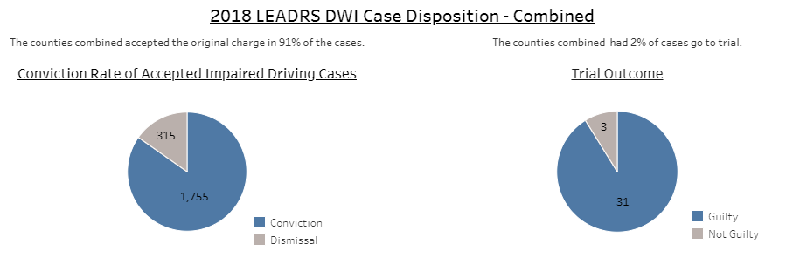
Conviction rate of accepted DWI arrest
85%
Conviction rate

Slide 16
Coming soon
Adding STEP IDM agencies
DRE evaluations data
Making main data reports available for download for LE agencies (Highcharts)
Officer profile data on LEADRS log-in

